Slide 1
UNIT 8 Representation and Descriptors
Prepared by
Er.Harendra Bikram Shah (Lecturer)
Department of Computer Engineering

Slide 2
OUTLINES
Representation and Its Techniques
Descriptors and Its Techniques

Slide 3
REPRESENTATION AND ITS TECHNIQUES
Introduction to Representation:
This steps comes after the image segmentation.
Image segmentation turns the image into raw data and pixels deposited along the boundary or region
Representation is a naming process in simple word.
Applications of Representation :
Medical Imaging:
Object Recognition:
Remote Sensing:
Computer Vision and Robotics:
Image Compression:
Biometrics:
Computer Graphics:
Image Segmentation:

Slide 4
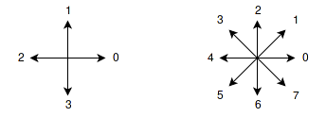
METHODS OF REPRESENTATION
Chain Codes
Signatures
Chain Codes:
Chain code is a method of describing the shape of the boundary of an object in an image
It is denoted by either a 4-connected neighbourhood or a 8-connected neighbourhood

Slide 5
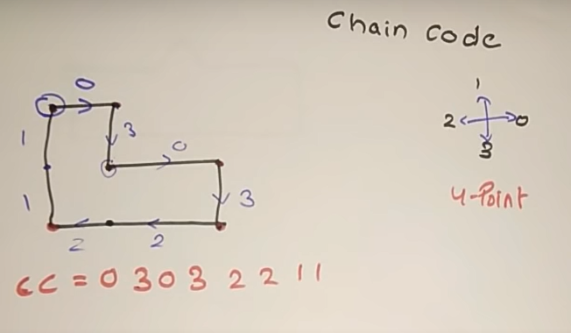
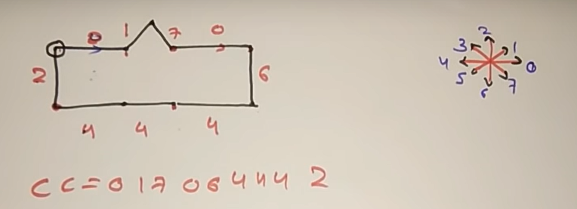

Slide 6
PROBLEMS WITH CHAIN CODES AND ITS REMEDY
Problems :
IF we change starting point the whole CC changes
If we use reflex Image then also the whole CC Changes
IF we rotate the image then also the whole CC changes
Solution:
1. Finding cc
2. Finding the Circular First Difference [CFD]
3. Finally finding Normalize CC from CFD.

Slide 7
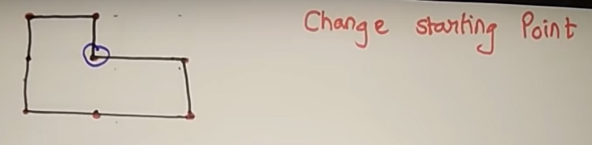
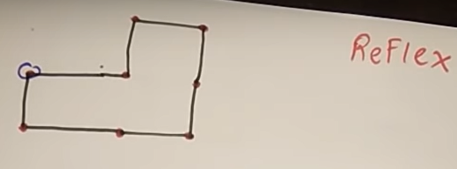
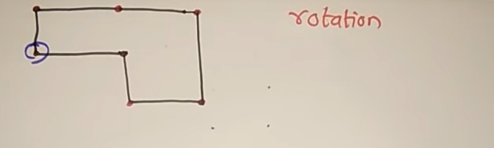

Slide 8
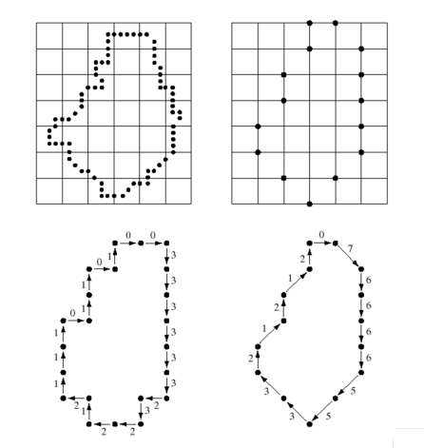

Slide 9
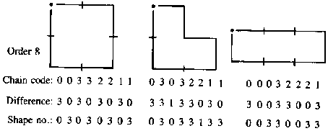

Slide 10
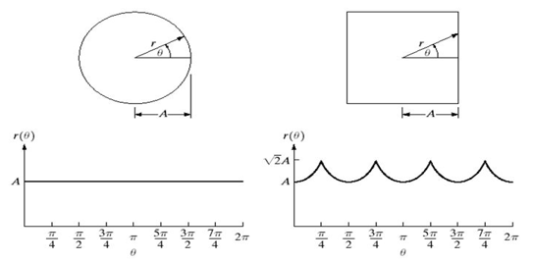
SIGNATURE
A 1‐D functional representation of a 2-D closed curved boundary of an object.
Signature is a plot of distance from the centroid to the boundary as function of angle.

Slide 11
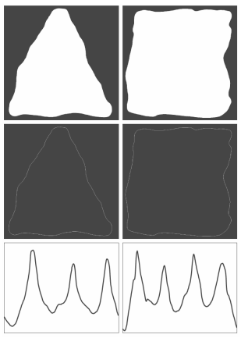
Irregular objects Signature's

Slide 12
DESCRIPTORS
Two types of Boundary Descriptors:
Shape Numbers
Fourier Descriptors
first difference circular chain code.
Fourier Transformation of Complex Coefficient values.

Slide 13
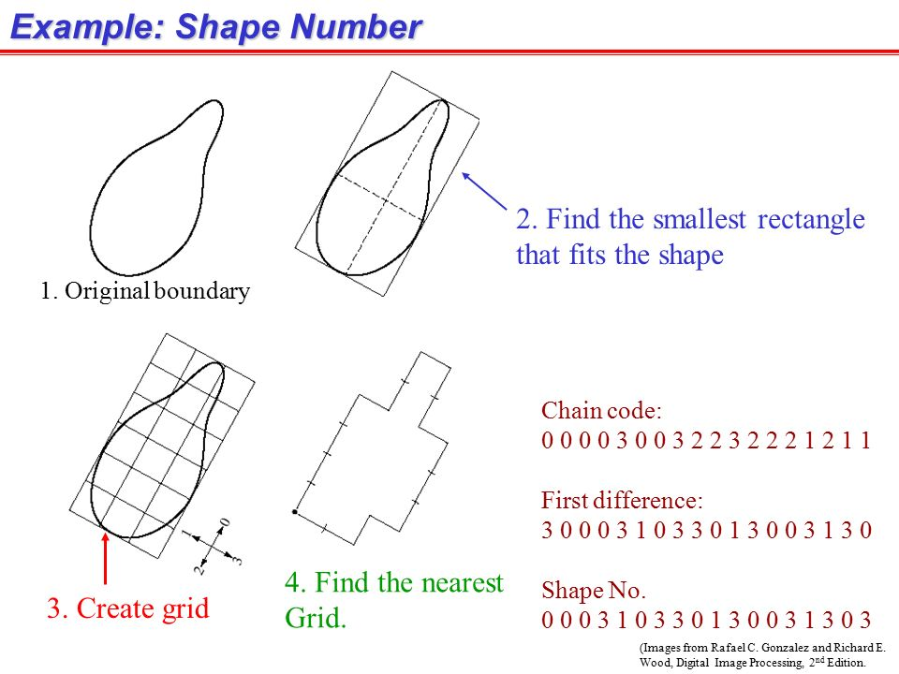

Slide 14
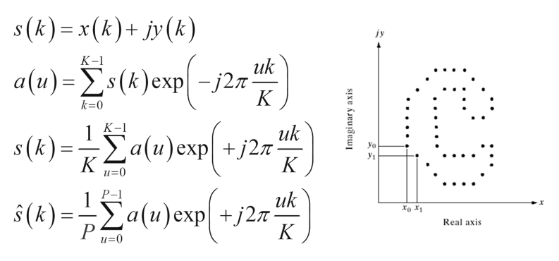

Fourier Descriptors
Where P is preceding equation for a(u)
=Approximation to S(k)

Slide 15
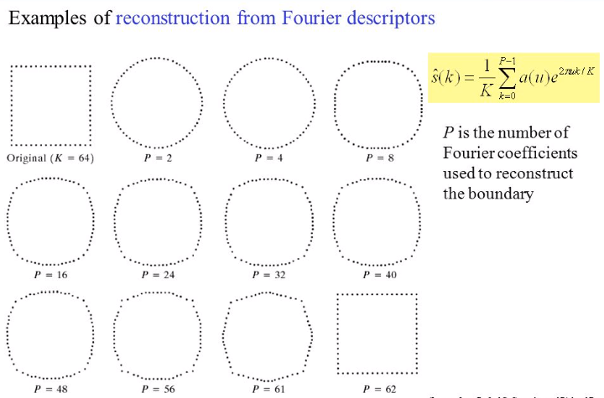
FOURIER DESCRIPTORS

Slide 16
End of UNIT 8

